Slide 1
Introduction to the Writing Centre and PAC
2023-24

Slide 2
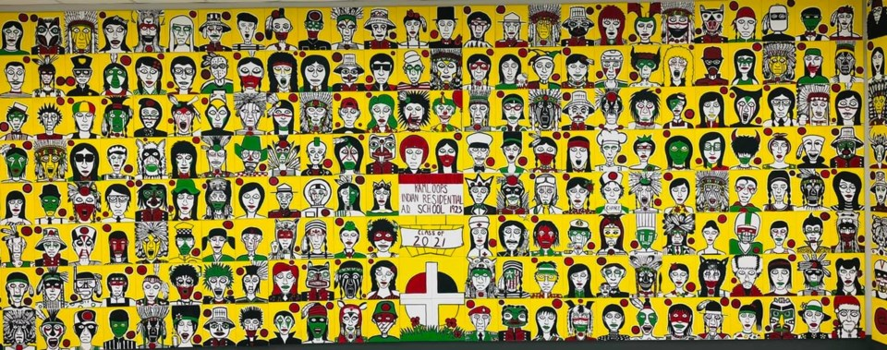
Artwork by Johnny Bandura
Thompson Rivers University campuses are on the traditional lands of the Tk'emlúps te Secwépemc (Kamloops campus) and the T’exelc (Williams Lake campus) within Secwépemc'ulucw, the traditional and unceded territory of the Secwépemc. Our region also extends into the territories of the St’át’imc, Nlaka’pamux, Nuxalk, Tŝilhqot'in, Dakelh, and Syilx peoples.
Notes:
3 mins
The artwork is by Johnny Bandura, who channeled his feelings about the discovery of 215 children’s bodies at the former Kamloops Indian Residential School into a piece of art, painting 215 images of what each child may have become when he or she grew up.
Jenna’s spoken word land acknowledgement

Slide 3
Introductions
Who am I?
Writing Centre Coordinator, Assistant Teaching Professor
Step-mum, social justice warrior, mountain-adorer, mountain-biking fanatic, arbitrary hugger, book-consumer, burger-and-beer afficionado; never-not-awkward
Who are you?
What are some of the academic writing expectations in your OL course?

Slide 4
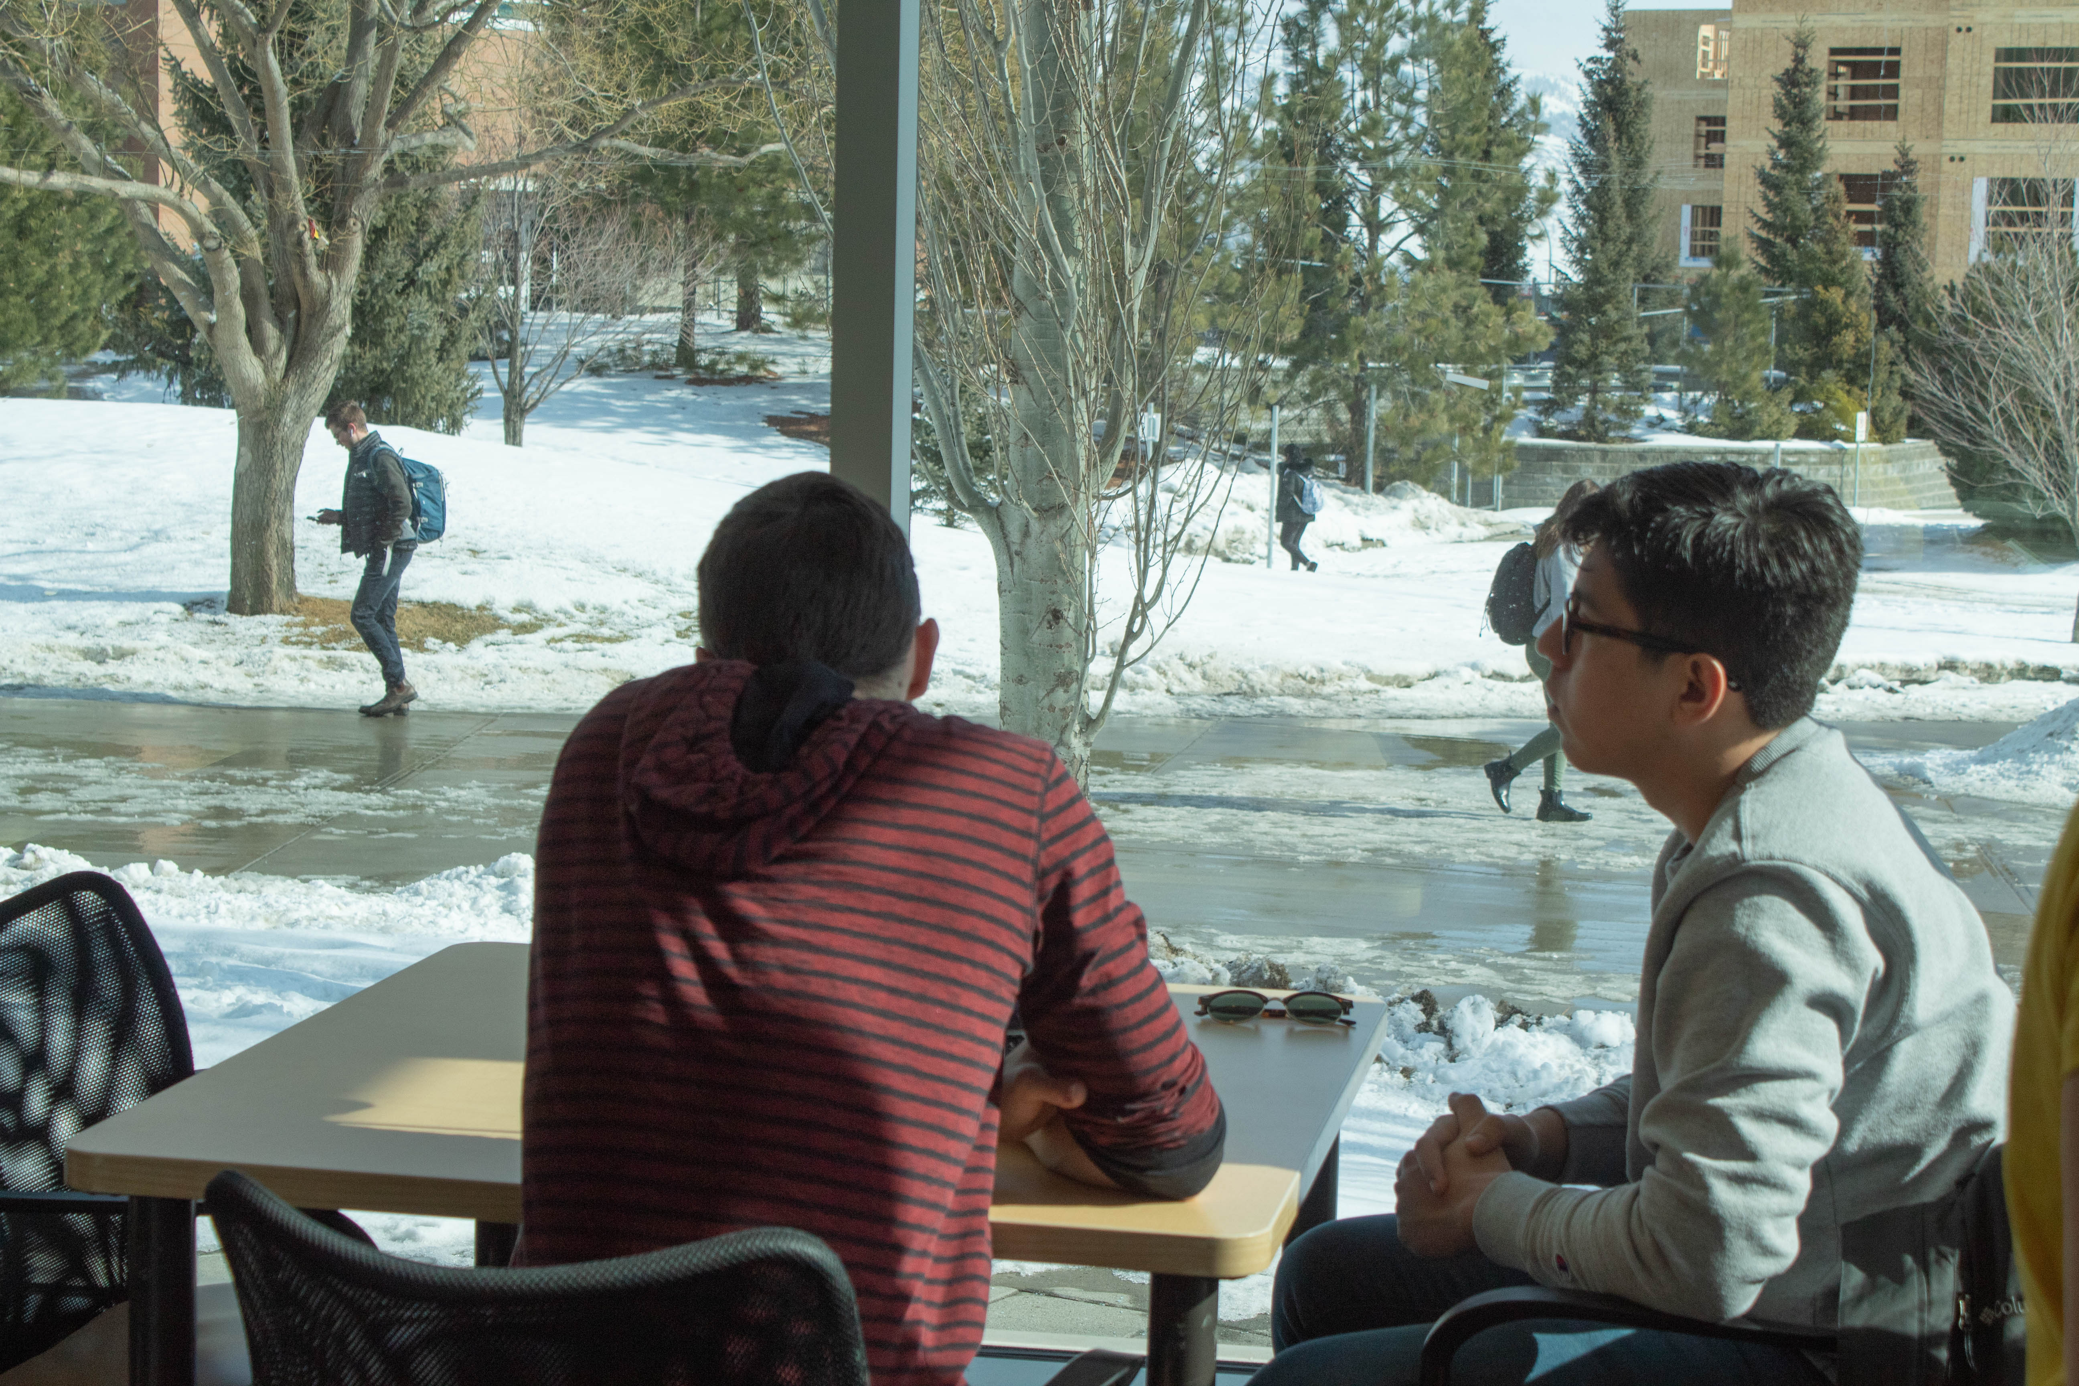
Academic writing is discipline-specific
Academic writing is culturally-specific
Academic writing is a process
A few things to consider:

Slide 5
Our Services
We are a FREE service staffed by skilled undergraduate and graduate students (provincial and local), community volunteers, and TRU faculty and staff.
Tutoring
Resources
What else?
WriteAway: three drafts accepted; 48-hour turnaround for feedback; provincial tutor
Writing Centre Online (WCOnline): three appointments/week; feedback uploaded by 11pm the same day; TRU tutor
Academic writing resources
Grammar resources
Citation resources
Videos
…and so much more!
If you’re on campus…
Free coffee and tea
Comfortable napping options
Creative Writing Fridays, 12-1pm
djfjf
TIP: looking for specific help? Read our tutors’ bios and book strategically!

Slide 6
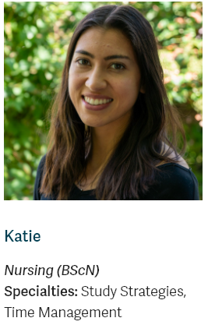
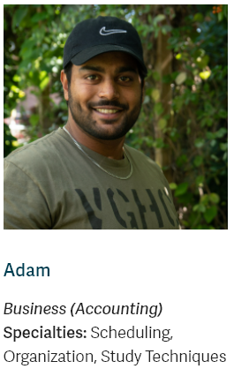
Peer Academic Coaching
What is Peer Academic Coaching?
One-on-one support with a peer mentor who can provide individualized strategies and resources on a range of academic challenges, including:
Time management
Studying
Note-taking
Test-taking and managing test-taking anxiety
Managing stress
Public speaking and presentations
As an OL student, you can book a synchronous appointment!

Slide 7
Location and Hours
OM 1411 or www.tru.ca/writingcentre
Monday-Friday, 9am-4pm
Tutoring appointments
WriteAway: Sept. 18-Dec. 6
Please upload your assignment instructions and your draft
This helps ensure you’re meeting the requirements of the assignment!
WCOnline: Dec. 10-Jan. 15

Slide 8
Managing Expectations
The Writing Centre ISN’T…
The Writing Centre IS…
Remedial
A place for “bad” writers; ALL students can benefit from having a second set of eyes on their writing!
An editing centre
A place to find support with course content
Perfect!
A space in which students can develop their writing skills and their authentic voice through discussions with tutors
A collaborative space that values diversity of people, voices, and thought
Actively working to dismantle White Language Supremacy (WLS)
Committed to linguistic justice and decolonizing academic writing spaces and processes

Slide 9
Let’s chat about ChatGPT!
What is “Generative AI” (GenAI)?
“Artificial intelligence” is a catch-all term that encompasses a wide range of machine learning technologies that use large data sets—collections of information—to make predictions or conclusions.
“Generative AI” is the class of tools where the AI doesn’t make decisions or predictions but instead appears to create—or generate!—something like an image, a paragraph, a video, or a sound file.

Slide 10
What ISN’T it?
It’s NOT a truth machine or a problem solver.
It’s NOT inventing, ideating, or innovating.
It’s NOT general intelligence.
It’s NOT functioning like a human brain.
It’s NOT sentient.
Important to keep in mind: there is nothing in this platform that is striving for TRUTH. We can’t assume the information it produces is correct (and often, for citations, it isn’t!).
It’s not designed to give you the RIGHT answer; it’s designed to give you a realistic answer based on the data set.
Prediction is NOT the same as accuracy.
Ask your instructor about their stance on using artificial intelligence tools in their class!

