Slide 1
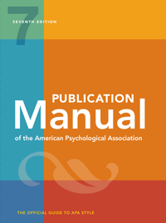
APA Style
American Psychological Association
Notes:
A style of citing sources and formatting papers according to the Publication Manual of the American Psychological Association.
APA Style is used in many disciplines, including education, social work and nursing.
APA Style has been around for a long time – since 1929 – and it changes very slowly, so some things about it may seem a bit old fashioned today.

Slide 2
Citing Sources in APA Style

Slide 3
An APA citation consists of two parts
In-text citation
The value that society places on manual labour has decreased over time (Crawford, 2009).
Reference
Crawford, M.­ B. (2009). Shop class as soul-craft: An inquiry in the value of work. Penguin Books.
Notes:
An APA citation consists of two parts.
The in-text citation goes in the text of the paper and indicates that a sourced is being cited.
The reference goes at the end of the paper and includes all of the information necessary to identify and locate the source. A References always includes the author, date and title, but what else is included depends on the type of source. In this case, the source is book, so we include the place of publication. This may seems odd today, because if we want to find a book we are likely to look for it online where it doesn’t really matter where it was physically published, but in 1929, if you were looking for a book, knowing where it was published would be a big help.

Slide 4
In-text Citations
Williams (2012) suggests that keeping pets is beneficial for seniors.
Research suggests that keeping pets is beneficial for seniors (Williams, 2012).
Research suggests that keeping pets has a “positive impact on older adults” (Williams, 2012, p. 10).
Notes:
If the author’s name is given in the text of the paper, then only the date goes inside the parentheses.
If the authors name is not given in the text of the paper, then it goes inside the parentheses with the date.
For direct quotes, the page number is also be included.
The in-text citation indicates that a source is being cited and acts as an arrow pointing to the corresponding reference. With very few exceptions, every in-text citation must correspond to a reference at the end of the paper. (The only exceptions are personal communication and religious or classical works, which are not included in the references.)

Slide 5
Reference
Williams, R. (2012). The role of companion animals in elder care. Gerontology, 10 (5), 5-15.
Notes:
The reference at the end of a paper gives all of the information necessary to identify and locate the source. Every in-text citation must correspond to a single reference, but one reference may correspond to many in-text citations.

Slide 6
An in-text citation corresponds to (at most) a single reference, but
One reference may correspond to many in-text citations.
In-Text Citation
In-Text Citation
In-Text Citation
In-Text Citation
In-Text Citation
In-Text Citation
Reference
Reference

Slide 7
In-text Citations
Christiuk (2012) says that “Northern nursing offers a unique scope of practice that integrates the determinants of health, principles of primary health care, strategies for urgent and emergent care, as well as curative, rehabilitative and palliative care” (p. 12). She also points out that rural nurses who work with First Nations must respect the traditional practices of those communities.
Later in the paper…
Some of the remote areas rural nurses live and work in involve travelling in all types of conditions by land, air and water (Christiuk, 2012). Fortunately, nurses working in such areas are eligible to receive an allowance to compensate for the high cost of living in such places (Government of Canada, 2020, February 2).
Notes:
If the author’s name is given in the text of the paper, then only the date goes inside the parentheses.
If the authors name is not given in the text of the paper, then it goes inside the parentheses with the date.
For direct quotes, the page number is also be included.
The in-text citation indicates that a source is being cited and acts as an arrow pointing to the corresponding reference. With very few exceptions, every in-text citation must correspond to a reference at the end of the paper. (The only exceptions are personal communication and religious or classical works, which are not included in the references.)

Slide 8
References
Christiuk, K. (2012). Scope of practice series: Nursing in a First Nations community. Manitoba RN Journal, 37(4), 12–13.
Government of Canada. (2020, February 2). Work-life balance, salary and allowances for nurses. https://www.sac-isc.gc.ca/eng/ 1580672006998/1580672137107
Notes:
The reference at the end of a paper gives all of the information necessary to identify and locate the source. Every in-text citation must correspond to a single reference, but one reference may correspond to many in-text citations.

Slide 9
References always include:
Who? The author
When? The date.
What? The title.
Where? The location.
How? How to access the source.
Notes:
The content of a reference varies depending on the type of source, but all references answer the same basic questions…

Slide 10
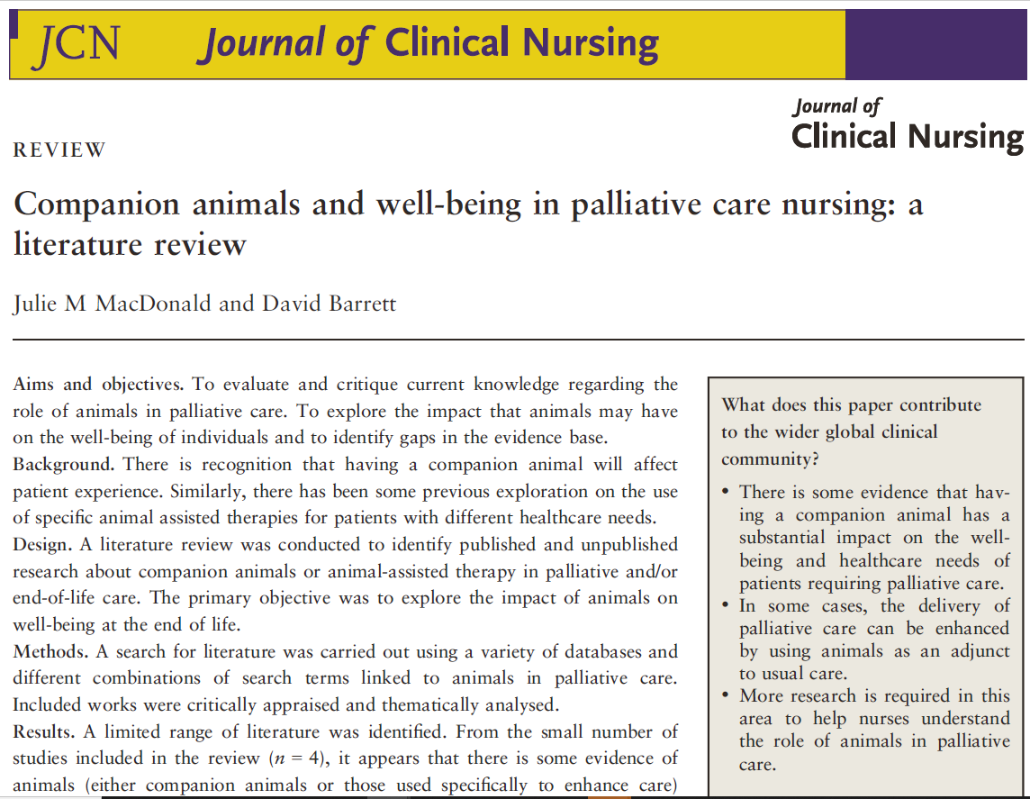
Journal Article
Notes:
So let’s have a look at the parts of an APA reference for an article in an academic journal.

Slide 11
Journal Article
MacDonald, J. M., & Barrett, D. (2016). Companion animals and well-being in palliative care nursing: A literature review. Journal of Clinical Nursing, 25(3-4), 300-310. https://doi.org/10.1111/jocn.13022
Notes:
So let’s have a look at the parts of an APA reference for an article in an academic journal.

Slide 12
Journal Article
MacDonald, J. M., & Barrett, D. (2016). Companion animals and well-being in palliative care nursing: A literature review. Journal of Clinical Nursing, 25(3-4), 300-310. https://doi.org/10.1111/jocn.13022
Notes:
So let’s have a look at the parts of an APA reference for an article in an academic journal.

Slide 13
Journal Article
MacDonald, J. M., & Barrett, D. (2016). Companion animals and well-being in palliative care nursing: A literature review. Journal of Clinical Nursing, 25(3-4), 300-310. https://doi.org/10.1111/jocn.13022
Notes:
So let’s have a look at the parts of an APA reference for an article in an academic journal.

Slide 14
Journal Article
MacDonald, J. M., & Barrett, D. (2016). Companion animals and well-being in palliative care nursing: A literature review. Journal of Clinical Nursing, 25(3-4), 300-310. https://doi.org/10.1111/jocn.13022
Notes:
So let’s have a look at the parts of an APA reference for an article in an academic journal.

Slide 15
Journal Article
MacDonald, J. M., & Barrett, D. (2016). Companion animals and well-being in palliative care nursing: A literature review. Journal of Clinical Nursing, 25(3-4), 300-310. https://doi.org/10.1111/jocn.13022
Notes:
So let’s have a look at the parts of an APA reference for an article in an academic journal.

Slide 16
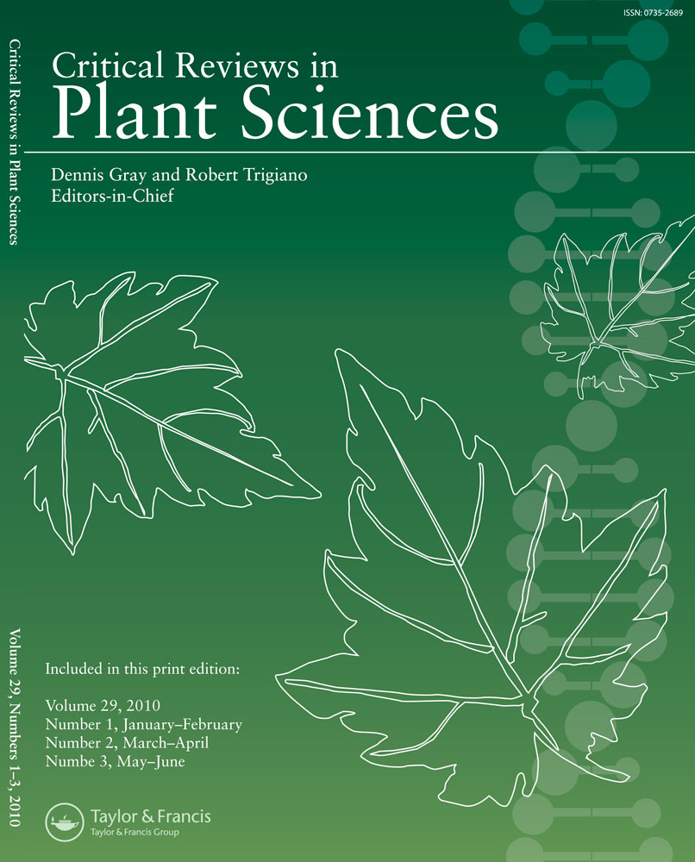
Issues & Volumes:
An issue is a single publication of a journal:
A volume is made up of all of the issues that are published in a calendar year:

Slide 17
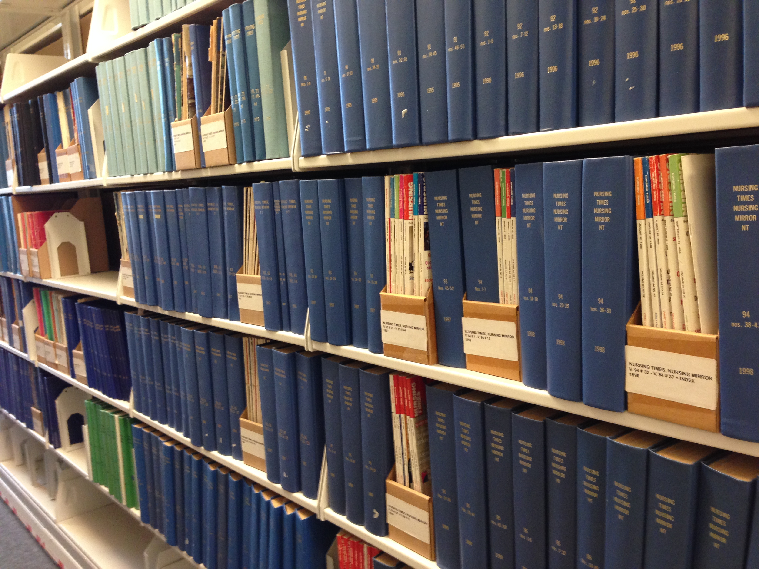
Notes:
This how we used to access journal articles. First we’d find the volume, Then we’d take it down from the shelf and find the issue, and only then, once we’d found the right issue, would we find the page numbers. This is why knowing the correct volume number, issue number and page numbers used to be so important for finding journal articles!

Slide 18
Journal Article
MacDonald, J. M., & Barrett, D. (2016). Companion animals and well-being in palliative care nursing: A literature review. Journal of Clinical Nursing, 25(3-4), 300-310. https://doi.org/10.1111/jocn.13022
Notes:
So let’s have a look at the parts of an APA reference for an article in an academic journal.

Slide 19
Journal Article
MacDonald, J. M., & Barrett, D. (2016). Companion animals and well-being in palliative care nursing: A literature review. Journal of Clinical Nursing, 25(3-4), 300-310. https://doi.org/10.1111/jocn.13022
Notes:
So let’s have a look at the parts of an APA reference for an article in an academic journal.

Slide 20
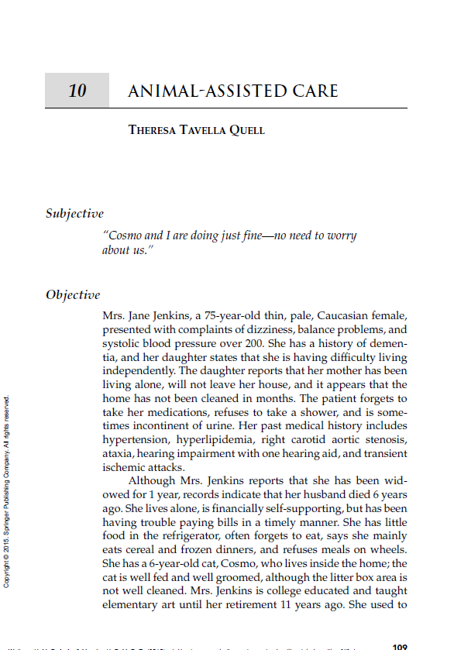
Book Chapter
Notes:
So let’s have a look at the parts of an APA reference for an article in an academic journal.

Slide 21
Book Chapter
Quell, T. T. (2015). Animal assisted care. In M. W. Kazer & K. Murphy (Eds.), Nursing case studies on improving health-related quality of life in older adults (pp. 109-118). Springer.
Notes:
Now let’s look at a chapter in a book…

Slide 22
Book Chapter
Quell, T. T. (2015). Animal assisted care. In M. W. Kazer & K. Murphy (Eds.), Nursing case studies on improving health-related quality of life in older adults (pp. 109-118). Springer.
Notes:
Now let’s look at a chapter in a book…

Slide 23
Book Chapter
Quell, T. T. (2015). Animal assisted care. In M. W. Kazer & K. Murphy (Eds.), Nursing case studies on improving health-related quality of life in older adults (pp. 109-118). Springer.
Notes:
Now let’s look at a chapter in a book…

Slide 24
Book Chapter
Quell, T. T. (2015). Animal assisted care. In M. W. Kazer & K. Murphy (Eds.), Nursing case studies on improving health-related quality of life in older adults (pp. 109-118). Springer.
Notes:
Now let’s look at a chapter in a book…

Slide 25
Book Chapter
Quell, T. T. (2015). Animal assisted care. In M. W. Kazer & K. Murphy (Eds.), Nursing case studies on improving health-related quality of life in older adults (pp. 109-118). Springer.
Notes:
Now let’s look at a chapter in a book…

Slide 26
Book Chapter
Quell, T. T. (2015). Animal assisted care. In M. W. Kazer & K. Murphy (Eds.), Nursing case studies on improving health-related quality of life in older adults (pp. 109-118). Springer.
Notes:
Now let’s look at a chapter in a book…

Slide 27
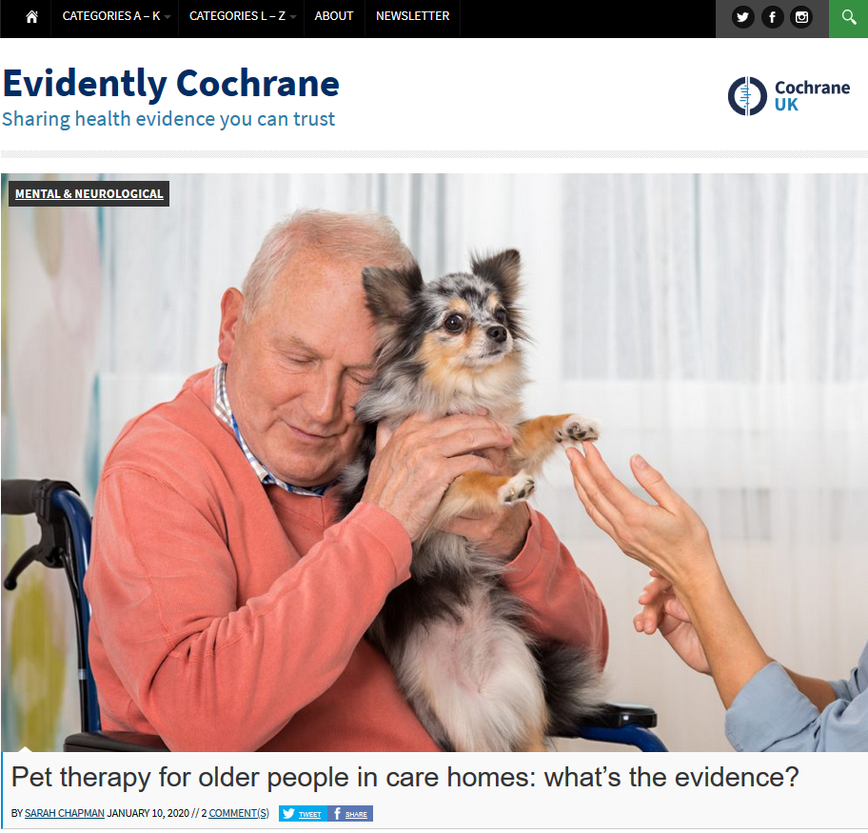
Webpage
Notes:
So let’s have a look at the parts of an APA reference for an article in an academic journal.

Slide 28
Webpage
Chapman, S. (2020, January 10). Pet therapy for older people in care homes: What’s the evidence? Evidently Cochrane. https://www.evidentlycochrane.net/pet-therapy
Notes:
So let’s have a look at the parts of an APA reference for an article in an academic journal.

Slide 29
Webpage
Chapman, S. (2020, January 10). Pet therapy for older people in care homes: What’s the evidence? Evidently Cochrane. https://www.evidentlycochrane.net/pet-therapy
Notes:
So let’s have a look at the parts of an APA reference for an article in an academic journal.

Slide 30
Webpage
Chapman, S. (2020, January 10). Pet therapy for older people in care homes: What’s the evidence? Evidently Cochrane. https://www.evidentlycochrane.net/pet-therapy
Notes:
So let’s have a look at the parts of an APA reference for an article in an academic journal.

Slide 31
Webpage
Chapman, S. (2020, January 10). Pet therapy for older people in care homes: What’s the evidence? Evidently Cochrane. https://www.evidentlycochrane.net/pet-therapy
Notes:
So let’s have a look at the parts of an APA reference for an article in an academic journal.

Slide 32
Webpage
Chapman, S. (2020, January 10). Pet therapy for older people in care homes: What’s the evidence? Evidently Cochrane. https://www.evidentlycochrane.net/pet-therapy
Notes:
So let’s have a look at the parts of an APA reference for an article in an academic journal.

Slide 33
Webpage
Chapman, S. (2020, January 10). Pet therapy for older people in care homes: What’s the evidence? Evidently Cochrane. https://www.evidentlycochrane.net/pet-therapy
Notes:
So let’s have a look at the parts of an APA reference for an article in an academic journal.

Slide 34
Government Report

Slide 35
Report
Government Report
Public Health Agency of Canada. (2019). A dementia strategy for Canada: Together we aspire. Government of Canada. https://www.canada.ca/ content/dam/phac-aspc/images/services/ publications/diseases-conditions/dementia-strategy/ National%20Dementia%20Strategy_ENG.pdf
Notes:
So let’s have a look at the parts of an APA reference for an article in an academic journal.

Slide 36
Report
Government Report
Public Health Agency of Canada. (2019). A dementia strategy for Canada: Together we aspire. Government of Canada. https://www.canada.ca/ content/dam/phac-aspc/images/services/ publications/diseases-conditions/dementia-strategy/ National%20Dementia%20Strategy_ENG.pdf
Notes:
So let’s have a look at the parts of an APA reference for an article in an academic journal.

Slide 37
Report
Government Report
Public Health Agency of Canada. (2019). A dementia strategy for Canada: Together we aspire. Government of Canada. https://www.canada.ca/ content/dam/phac-aspc/images/services/ publications/diseases-conditions/dementia-strategy/ National%20Dementia%20Strategy_ENG.pdf
Notes:
So let’s have a look at the parts of an APA reference for an article in an academic journal.

Slide 38
Report
Government Report
Public Health Agency of Canada. (2019). A dementia strategy for Canada: Together we aspire. Government of Canada. https://www.canada.ca/ content/dam/phac-aspc/images/services/ publications/diseases-conditions/dementia-strategy/ National%20Dementia%20Strategy_ENG.pdf
Notes:
So let’s have a look at the parts of an APA reference for an article in an academic journal.

Slide 39
Report
Government Report
Public Health Agency of Canada. (2019). A dementia strategy for Canada: Together we aspire. Government of Canada. https://www.canada.ca/ content/dam/phac-aspc/images/services/ publications/diseases-conditions/dementia-strategy/ National%20Dementia%20Strategy_ENG.pdf
Notes:
So let’s have a look at the parts of an APA reference for an article in an academic journal.

Slide 40
Report
Government Report
Public Health Agency of Canada. (2019). A dementia strategy for Canada: Together we aspire. Government of Canada. https://www.canada.ca/ content/dam/phac-aspc/images/services/ publications/diseases-conditions/dementia-strategy/ National%20Dementia%20Strategy_ENG.pdf
Notes:
So let’s have a look at the parts of an APA reference for an article in an academic journal.

Slide 41
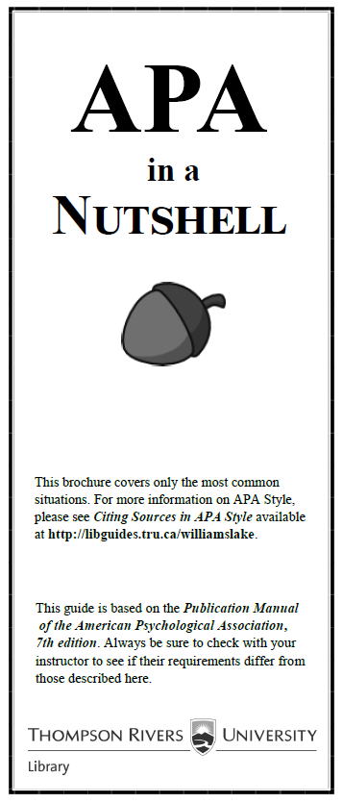
Notes:
A Guide to APA Citation 7th Style goes into great detail about how to cite various kind of sources. But no source is perfect, so whether you type in your references or paste them in from Discover or another database, you must remember to proofread them.

Slide 42
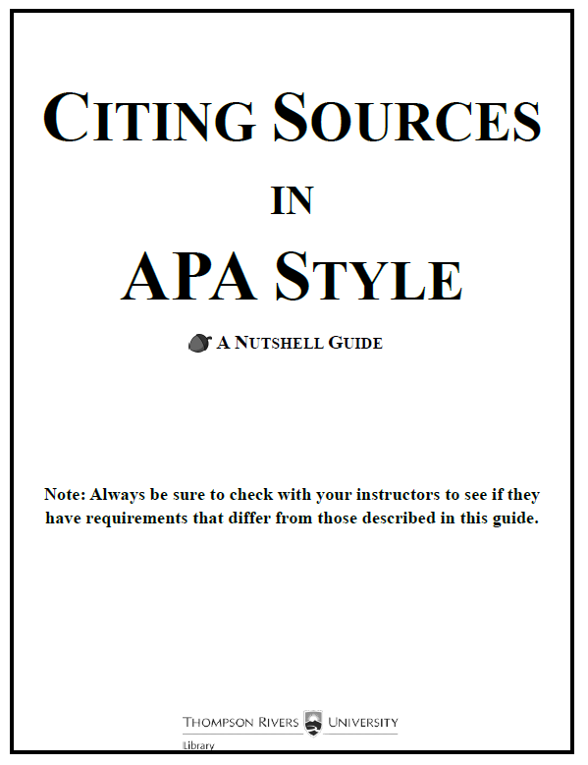
Notes:
A Guide to APA Citation 7th Style goes into great detail about how to cite various kind of sources. But no source is perfect, so whether you type in your references or paste them in from Discover or another database, you must remember to proofread them.

Slide 43
http://libguides.tru.ca/melissa
Notes:
The template that I used to format the above paper in APA style is available from…
Style: a bundle of specifications that together format text in a specific way.

Slide 44
http://www.tru.ca/library.html
Notes:
Fortunately, we can often copy and paste APA citations from various sources, including the TRU Library’s Discover Search Service.

Slide 45
Proofread: v. To slowly and carefully read through a text in order to find and correct mistakes.
Notes:
What does it mean by proofread something? To proofread is to slowly and carefully read through a text in order to find and correct mistakes. So to proofread a reference is to read through it very carefully looking for mistakes.

Slide 46
What kinds of mistakes?
Punctuation
Capitalization
Italicization
Missing elements
Notes:
Some things might be left out altogether, like DOIs and URLs.

Slide 47
Find the error:
Olsen, C., Pedersen, I., Bergland, A., Enders-Slegers, M-J., & Ihlebæk, C. (2016). Effect of animal-assisted activity on balance and quality of life in home-dwelling persons with dementia. Geriatric Nursing, 37(4). https://doi.org/10.1016/ j.gerinurse.2016.04.002

Slide 48
Answer:
Olsen, C., Pedersen, I., Bergland, A., Enders-Slegers, M-J., & Ihlebæk, C. (2016). Effect of animal-assisted activity on balance and quality of life in home-dwelling persons with dementia. Geriatric Nursing, 37(4), 284–291. https://doi.org/10.1016/ j.gerinurse.2016.04.002

Slide 49
Find the errors:
Olsen, C., Pedersen, I., Bergland, A., Enders-Slegers, M.-J., & Ihlebaek, C. (20190101). Engagement in elderly persons with dementia attending animal-assisted group activity. DEMENTIA -INTERNATIONAL JOURNAL OF SOCIAL RESEARCH AND PRACTICE, 18(1), 245–261. https://doi.org/10.1177/1471301216667320

Slide 50
Answers
Olsen, C., Pedersen, I., Bergland, A., Enders-Slegers, M.-J., & Ihlebaek, C. (2019). Engagement in elderly persons with dementia attending animal-assisted group activity. Dementia - International Journal of Social Research and Practice, 18(1), 245–261. https://doi.org/10.1177/1471301216667320

Slide 51
Find the errors:
Peluso, S., De Rosa, A., De Lucia, N., Antenora, A., Illario, M., Esposito, M., & De Michele, G. (2018). animal-assisted therapy in elderly patients: evidence and controversies in dementia and psychiatric disorders and future perspectives in other neurological diseases. Journal Of Geriatric Psychiatry And Neurology, 31(3), 149–157. https://doi.org/10.1177/0891988718774634

Slide 52
Answers:
Peluso, S., De Rosa, A., De Lucia, N., Antenora, A., Illario, M., Esposito, M., & De Michele, G. (2018). Animal-assisted therapy in elderly patients: Evidence and controversies in dementia and psychiatric disorders and future perspectives in other neurological diseases. Journal of Geriatric Psychiatry and Neurology, 31(3), 149–157. https://doi.org/10.1177/0891988718774634

Slide 53
Find the error:
Baek, S-M., Lee, Y., & Sohng, K-Y. (2020). The psychological and behavioural effects of an animal-assisted therapy programme in Korean older adults with dementia. Psychogeriatrics. https://doi.org/10.1111/psyg.12554

Slide 54
Answer:
Baek, S-M., Lee, Y., & Sohng, K-Y. (2020). The psychological and behavioural effects of an animal-assisted therapy programme in Korean older adults with dementia. Psychogeriatrics. 20(5), 645-653. https://doi.org/10.1111/psyg.12554

Slide 55
Find the error:
Forget, S., Pennequin, V., Agli, O., & Bailly, N. (2021). Brakes and levers to implement an animal-assisted intervention in nursing homes: Preliminary study. Complementary Therapies in Medicine, 56, 1-7. https://doi.org/10.1016/j.ctim.2020.102591

Slide 56
Answer:
Forget, S., Pennequin, V., Agli, O., & Bailly, N. (2021). Brakes and levers to implement an animal-assisted intervention in nursing homes: Preliminary study. Complementary Therapies in Medicine, 56, 1-7. https://doi.org/10.1016/j.ctim.2020.102591

Slide 57
Find the error:
Charry-Sánchez, J. D., Pradilla, I., and Talero-Gutiérrez, C. (2018). Animal-assisted therapy in adults: A systematic review. Complementary Therapies in Clinical Practice, 32, 169–180. https://doi.org/10.1016/j.ctcp.2018.06.011

Slide 58
Answer:
Charry-Sánchez, J. D., Pradilla, I., & Talero-Gutiérrez, C. (2018). Animal-assisted therapy in adults: A systematic review. Complementary Therapies in Clinical Practice, 32, 169–180. https://doi.org/10.1016/j.ctcp.2018.06.011

Slide 59
Find the error:
Yakimicki, M. L., Edwards, N. E., Richards, E., & Beck, A. M. (n.d.). Animal-assisted intervention and dementia: A systematic review. Clinical Nursing Research, 28(1), 9–29. https://doi.org/10.1177/1054773818756987

Slide 60
Answer:
Yakimicki, M. L., Edwards, N. E., Richards, E., & Beck, A. M. (2019). Animal-assisted intervention and dementia: A systematic review. Clinical Nursing Research, 28(1), 9–29. https://doi.org/10.1177/1054773818756987

Slide 61
Find the error:
Heerema, E. (2020, February 7). How does pet therapy benefit people with dementia? https://www.verywellhealth.com/how-does-pet-therapy-benefit-people-with-dementia-98677

Slide 62
Answer:
Heerema, E. (2020, February 7). How does pet therapy benefit people with dementia? Verywell Heath. https://www.verywellhealth.com/how-does-pet-therapy-benefit-people-with-dementia-98677

Slide 63
Find the errors:
World Health Organization. Towards a dementia plan: a WHO guide. https://apps.who.int/iris/bitstream/ handle/10665/272642/9789241514132-eng.pdf?ua=1

Slide 64
Answer:
World Health Organization. (2018). Towards a dementia plan: A WHO guide. https://apps.who.int/iris/ bitstream/handle/10665/272642/9789241514132-eng.pdf?ua=1

Slide 65
Find the errors:
O’Connor-Von, S. (2018). Animal-assisted therapy. In R. Lindquist, M. F. Tracy & M. Snyder, Complementary and alternative therapies in nursing (8th ed.). Springer Publishing Company. https://doi.org/10.1891/9780826144348

Slide 66
Answers:
O’Connor-Von, S. (2018). Animal-assisted therapy. In R. Lindquist, M. F. Tracy & M. Snyder (Eds), Complementary and alternative therapies in nursing (8th ed., pp. 225-246). Springer Publishing Company. https://doi.prg/ 10.1891/9780826144348

Slide 67
Find the error:
OReilly, J. & Shatz, R. (2019). Dementia and Alzheimer’s: Solving the practical and policy challenges. Anthem Press.

Slide 68
Answer:
OReilly, J. & Shatz, R. (2019). Dementia and Alzheimer’s: Solving the practical and policy challenges. Anthem Press. https://doi.org/10.2307/j.ctvg5bsr1

Slide 69
Find the error:
Prof. Samantha Hurn. (2012). Humans and other animals: Cross-cultural perspectives on human-animal interactions. Pluto Press.

Slide 70
Answer:
Hurn, S. (2012). Humans and other animals: Cross-cultural perspectives on human-animal interactions. Pluto Press.

Slide 71
Find the error:
Aarskog, Nina Karin, Hunskår, Irene, & Bruvik, Frøydis. (2019). Animal-assisted interventions with dogs and robotic animals for residents with dementia in nursing homes: A systematic review. Physical & Occupational Therapy in Geriatrics, 37(2), 77–93. https://doi.org/10.1080/02703181.2019.1613466

Slide 72
Answer:
Aarskog, N. K., Hunskår, I., & Bruvik, F. (2019). Animal-assisted interventions with dogs and robotic animals for residents with dementia in nursing homes: A systematic review. Physical & Occupational Therapy in Geriatrics, 37(2), 77–93. https://doi.org/10.1080/02703181.2019.1613466

Slide 73
Find the error:
Berglund, J. (2014). Princely companion or object of offense? The dog’s ambiguous status in Islam. Society & Animals, 22(6); 545–559. https://doi-org.ezproxy.tru.ca/10.1163/15685306-12341357

Slide 74
Answer:
Berglund, J. (2014). Princely companion or object of offense? The dog’s ambiguous status in Islam. Society & Animals, 22(6), 545–559. https://doi-org.ezproxy.tru.ca/10.1163/15685306-12341357

Slide 75
Find the error:
Renzetti, E. (2020, April 17). The aged: Lovely in theory, disposable in fact. The Globe and Mail. https://www.theglobeandmail.com/opinion/article-the-aged-lovely-in-theory-disposable-in-fact

Slide 76
Find the error:
Renzetti, E. (2020, April 17). The aged: Lovely in theory, disposable in fact. The Globe and Mail. https://www.theglobeandmail.com/opinion/article-the-aged-lovely-in-theory-disposable-in-fact

Slide 77
Find the error:
Batubara, S. O., Tonapa, S. I., Saragih, I. D., Mulyadi, M., & Lee, B.-O. (2022). Effects of animal-assisted interventions for people with dementia: A systematic review and meta-analysis. Geriatric Nursing, 43, 26–37. https://doi-org.ezproxy.tru.ca/10.1016 /j.gerinurse.2021.10.016
Notes:
The reference at the end of a paper gives all of the information necessary to identify and locate the source. Every in-text citation must correspond to a single reference, but one reference may correspond to many in-text citations.

Slide 78
Find the error:
Batubara, S. O., Tonapa, S. I., Saragih, I. D., Mulyadi, M., & Lee, B.-O. (2022). Effects of animal-assisted interventions for people with dementia: A systematic review and meta-analysis. Geriatric Nursing, 43, 26–37. https://doi-org.ezproxy.tru.ca/10.1016 /j.gerinurse.2021.10.016
Notes:
The reference at the end of a paper gives all of the information necessary to identify and locate the source. Every in-text citation must correspond to a single reference, but one reference may correspond to many in-text citations.

Slide 79
Formatting Papers
in APA Style

Slide 80
There are many rules for correctly formatting a paper in APA Style.

Slide 81
All headings and text must be in one of these fonts:
11 pt. Calibri 11 pt. Arial
10 pt. Lucinda Sans Unicode 11 pt. Georgia
12 pt. Times New Roman

Slide 82
The entire paper must be double spaced.
This text is double spaced, which means that there is text on every second line, leaving a lot of space between the lines.

Slide 83
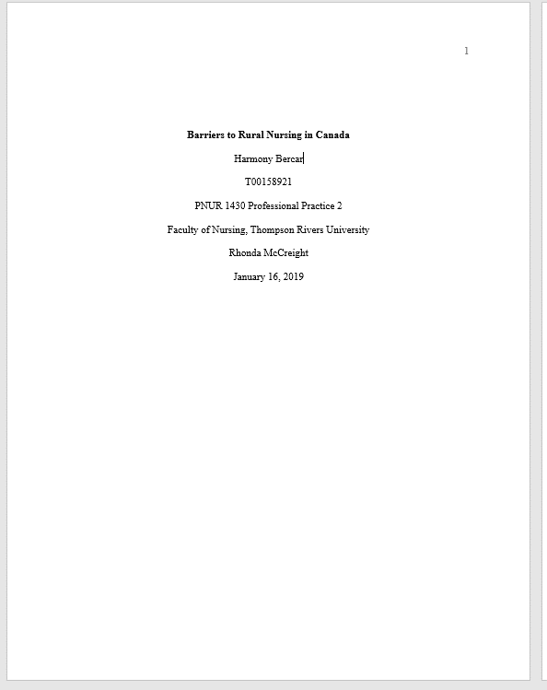
There must be a title page.

Slide 84
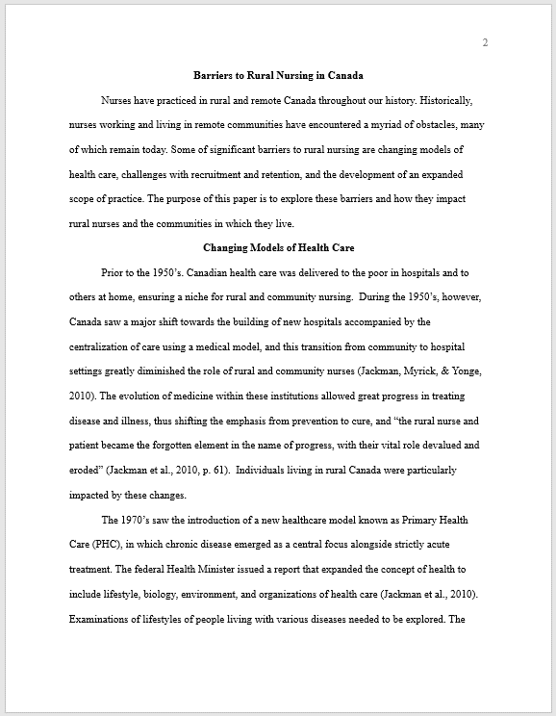
All four margins must be set to 1 inch (2.5cm).

Slide 85
The pages must be numbered in the top right corner.

Slide 86
The title must be repeated, centred and bolded, at the top of the first page of text.

Slide 87
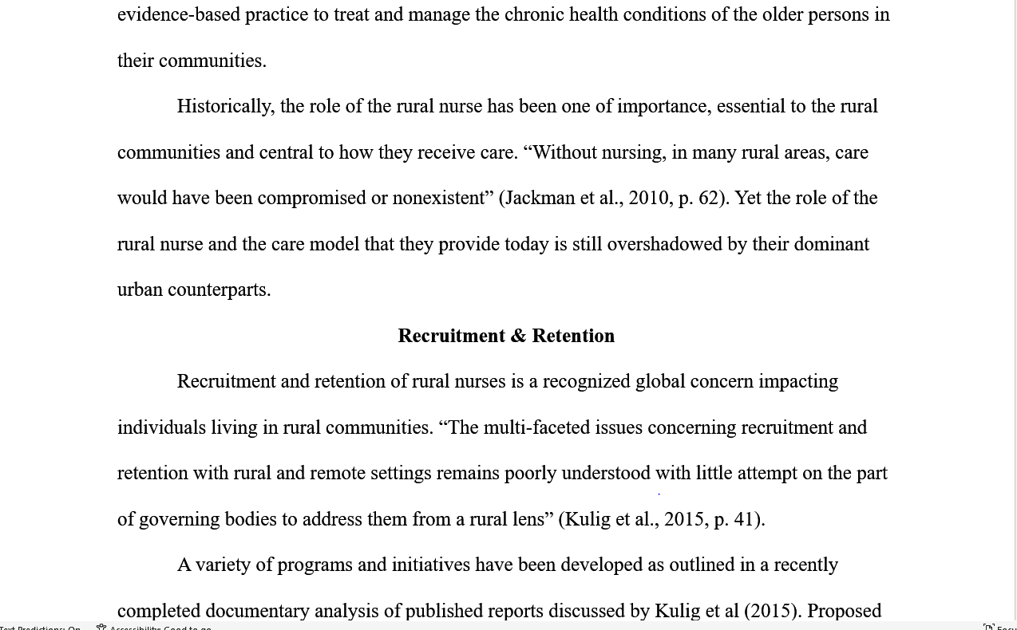
Level 1 headings must be centred and bolded.

Slide 88
Other headings must be formatted according to level.

Slide 89
The references must be formatted with hanging indents.

Slide 90
We can set up all this stuff in a Word Document…
Or we can use a ready-made template.

Slide 91
Template: A computer file configured to create a particular type of document.

Slide 92
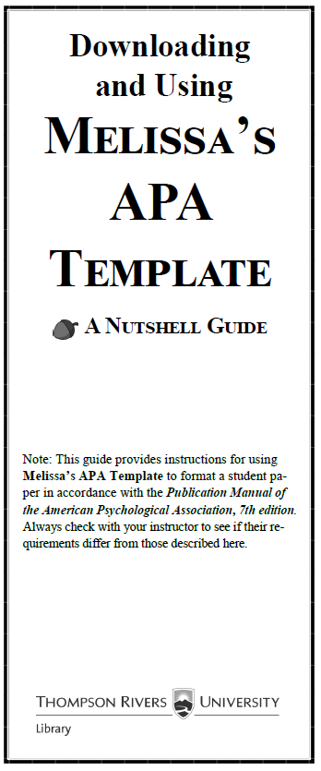
Notes:
A Guide to APA Citation 7th Style goes into great detail about how to cite various kind of sources. But no source is perfect, so whether you type in your references or paste them in from Discover or another database, you must remember to proofread them.

Slide 93
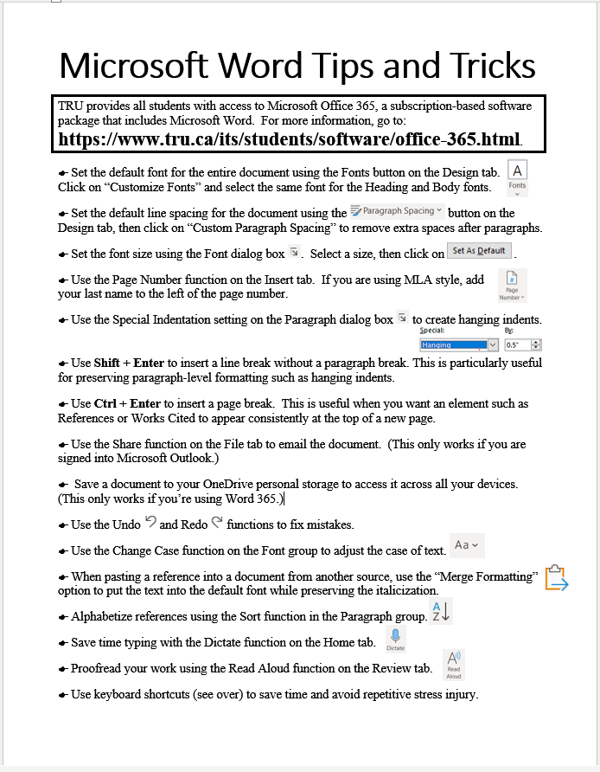
Notes:
A Guide to APA Citation 7th Style goes into great detail about how to cite various kind of sources. But no source is perfect, so whether you type in your references or paste them in from Discover or another database, you must remember to proofread them.

Slide 94
Notes:
A Guide to APA Citation 7th Style goes into great detail about how to cite various kind of sources. But no source is perfect, so whether you type in your references or paste them in from Discover or another database, you must remember to proofread them.

Slide 95
http://libguides.tru.ca/melissa
Notes:
The template that I used to format the above paper in APA style is available from…
Style: a bundle of specifications that together format text in a specific way.

Slide 96
Getting Help with Citation
Ask Me!
E-mail me at msvendsen@tru.ca.
Make an appointment at https://tru.libcal.com/appointments/.

